Slide 1
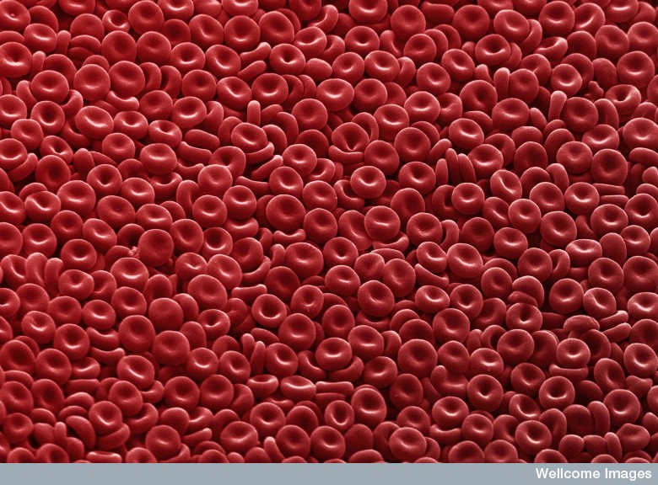
Cell Structure and Function
Chapter 3

Slide 2
Video #1 – The Wacky History of Cell Theory
Video #2 – How We Think Complex Cells Evolved
Video #3 – Cell vs. Virus: A Battle for Health
Video #4 – The Operating System of Life
Video #5 – How do Cancer Cells Behave Differently from Healthy Ones?

Slide 3
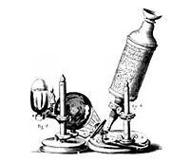
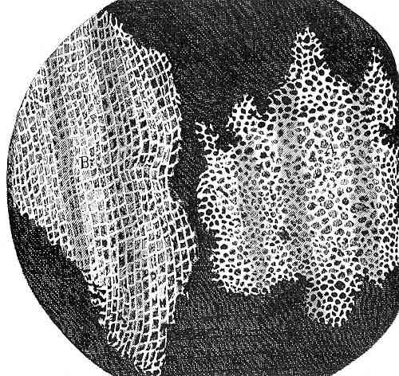
I. Discovery of the Cell
A. Our knowledge of cells is built on work done with microscopes
1. English scientist Robert Hooke in 1665 first described cells from his observations of cork slices. Hooke first used the word "cell".

Slide 4
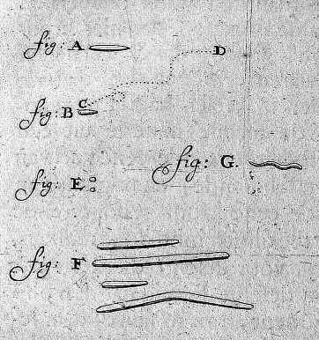
2. Dutch amateur scientist Antonie van Leeuwenhoek discovered microscopic animals in water
3. German scientists Schleiden and Schwann in 1830's were first to say that “all organisms are made of one or more cells.”
4. German biologist Virchow in 1858 stated that all cells come from the “division of pre-existing cells.”

Slide 5
II. Cell Theory
All living organisms are made up of one or more cells
The cell is the basic unit of life
All cells come from the division of pre-existing cells

Slide 6
III.Cells
A. Living things exist at a cellular or
multi-cellular level
B. Life occurs only in cells…
  1. Molecules or materials outside of cells are not considered living
  2. Once they are taken in and become incorporated into the cytoplasm or molecules of the cell they are considered living
  Molecules present carry on biochemical reactions in an organized manner
C. Cells carry on all the processes associated with life, such as reproducing and interacting with the environment

Slide 7
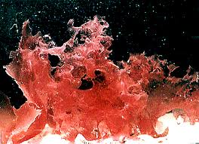
IV. Cell Size
A. Cells come in many shapes and sizes, although most are microscopic:
  1. Most cells are small, about 0.001 cm in length (1/100 of a mm, or 10 μm).
  2. Smallest cells are 0.3 μm in size
  3. Some cells are large
    a. e.g. some giant algal cells may be several centimeters long
    b. A chicken's egg is a single cell

Slide 8
40,000 red blood cells would fill the letter "O" on a page of type. You produce about 2.5 million new red blood cells every second!
Each square cm of your skin contains about 150,000 skin cells.
Human beings are composed of about 50 to 100 trillion cells. Micrograph Images
Ted-Ed Electron

Slide 9
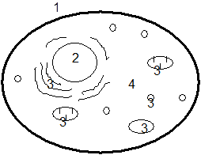
V. Eukaryote Cells
A. The cell's overall structure can be viewed as:
  Cell Membrane
  Nucleus
  Organelles
  Cytoplasm

Slide 10
1. Cell Membrane: the thin layer which separates the cell contents from it's environment. Plant cells also have a cell wall surrounding the cell membrane.
2. Nucleus: specialized structure within the cell which contains DNA and controls cell functioning and reproduction.
3. Organelles: small bodies with specific structures and functions within the cell.
4. Cytoplasm: the liquid substance between the nucleus and the cell membrane, in which the organelles are located.

Slide 11
VI.Cell Structures and Their Functions :
Endosymbiont Theory ANIMATION
Molecular Happenings in cells ANIMATION

Slide 12
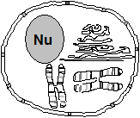
VI.Cell Structures and Their Functions
Nucleus
  Large, centrally located
  2. Surrounded by a double layer membrane with pores for selective intake and release of molecules - a nuclear envelope
  3. Contains:
  a. Nucleoplasm
  b. Chromosomes
  i. Contain DNA and organizer proteins (histones) densely coiled together
  ii. Only visible near the time of cell division, when condensed for “transport’’; otherwise it is called chromatin
  iii. Contains all the genetic code for the organism

Slide 13
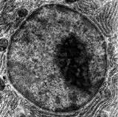
Nucleus Cont’d
  C. Nucleolus
    i. Dark-staining areas in the
    nucleus (usually spherical)
    ii. Contain genetic material for
    making a form of RNA called ribosomal RNA (rRNA)
    iii.rRNA travels to the cytoplasm, where it forms the sub-units of the ribosomes
4. Function: Transcription (reading) and replication (duplicating) of the genetic code occurs here

Slide 14
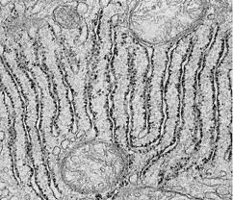
Ribosomes
1. Small dense-staining granules
2. Composed of rRNA and some proteins that are joined prior to migration to the ER
3. Found on surface of ER (for producing proteins to be exported out of cell)
4. Also found free-floating in cytoplasm in small groups called poly(ribo)somes
a. polysomes produce proteins to be used inside the cell.
5.Function: Involved in protein synthesis (ensure correct amino acids and makes peptide bonds

Slide 15
Endoplasmic Reticulum
ANIMATION

Slide 16
C. Rough ER (Endoplasmic Reticulum)
Series of tubular canals
connected in places with
nuclear membrane
2. Covered with ribosomes
  a. Ribosomes produce proteins to be exported out of cell
  b. Proteins move inside to the lumen of the E.R. , then on to the Golgi apparatus
3. Function: Produces/modifies proteins to be exported by the cell

Slide 17
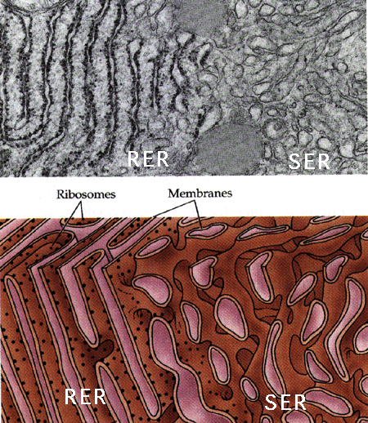
D. Smooth ER
1. Similar in structure to rough ER except no ribosomes on surface
2. Associated with lipid and steroid production [abundant in organs that produce steroid hormones (ovaries, testes, adrenal cortex)]

Slide 18
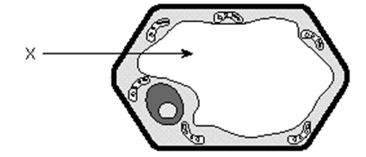
E. Vacuoles
Non-living, and much
larger in plant cells
Membrane-covered sack usually filled with water and waste chemicals
3. Small vacuoles are called vesicles

Slide 19
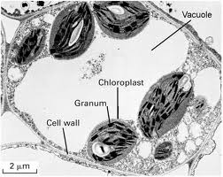
4. Function in plant cells:
  a. Have one large central vacuole that may occupy 90% of the cell volume
  b. Give rigidity to the cell (“pressurized”)
  c. Makes the cytoplasm into a thin layer against the cell membrane to allow for better gas exchange
  d. Storage of waste products of metabolism

Slide 20
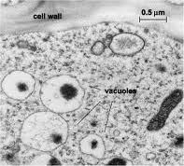
5. Function in animal cells:
  a. Digestion of food
  (e.g. food vacuoles in Amoeba)
  b. Elimination of excess water
  (e.g. contractile vacuole in
  Paramecium)

Slide 21
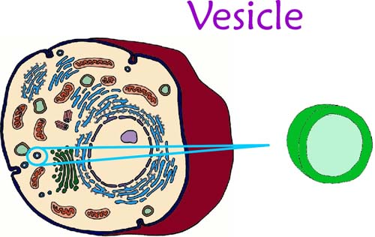
F. Vesicle
A small vacuole
2. Often used to move certain compounds require separation from the cytoplasm
(e.g. “bleb” off the Golgi, or are formed by infoldings of cell membrane)

Slide 22
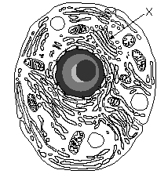
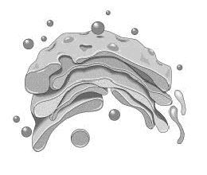
G. Golgi Body (Golgi Apparatus)
Looks like a series of flattened pancakes
2. Materials which are produced elsewhere in the cell (esp. E.R.) are temporarily stored here
3. Materials are packaged into vesicles
which pinch off from the edges
  a. These vesicles are distributed within the cell or are shipped to the cell membrane for excretion

Slide 23
H. Lysosomes
1. Membrane-covered vesicles of hydrolytic enzymes which move throughout the cell
2. Produced by the Golgi
3. Functions:
  a. Attach to food vacuoles and digest contents
  b. Destroy old or malfunctioning cell parts
  c. Destroy the cell itself if the cell becomes damaged or malfunctions

Slide 24

I. Mitochondria
cristae
matrix
  1. Double membraned structure where the inner membrane is highly infolded into cristae to increase inner surface area
  a. Cristae : where enzymes are arranged in order to carry out certain reactions

Slide 25
Found in both plant and animals cells
Have own DNA (endosymbiont hypothesis)
4. Function:
  Convert food energy to a form of energy which can be used by the cell (this energy is in the form of ATP: adenosine triphosphate)
  b. Process: cellular respiration
  Glucose + O₂ → CO₂ + H₂O + ATP energy
  c. The more active a cell is, the more mitochondria it will have (e.g. muscle & sperm cells
Clip: powering the cell

Slide 26
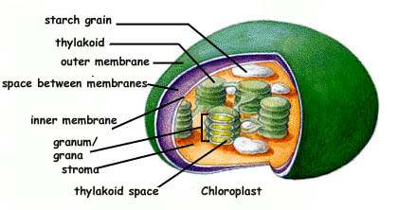
J. Plastids
Found only in plant cells
3 types of plastids:
a. Chloroplasts - most common
Structure:
  i. Have “coin-like” membrane sacks (thylakoids) arranged in “stacks” called grana that are joined together by lamellae (membranes between stacks)
    ii. The inner portion of the chloroplast is called the stroma

Slide 27
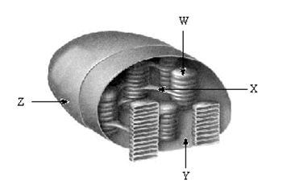
b. Contain chlorophyll (in grana)
  Site of photosynthesis
(H₂O + CO₂ → sugar + O₂)

Slide 28
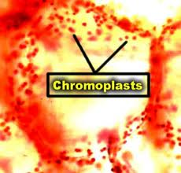
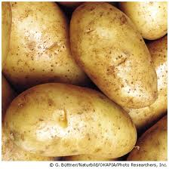
b. Chromoplasts
    Stores pigments other than chlorophyll (e.g. carotene, xanthophylls) that make carrots, peaches, autumn leaves, etc. yellow & orange)
c. Leucoplast
    Stores starch (e.g. in potatoes)

Slide 29
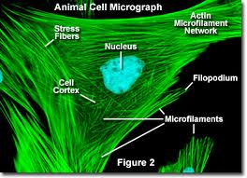
K. Microfilaments
1. Thin solid fibers of protein – similar to proteins in muscle fiber
2. Provide skeletal framework for the
cell (cytoskeleton)

Slide 30
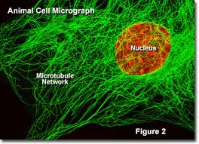
L. Microtubules
1. Larger than microfilaments
2. Proteins called tubulin are coiled in a cylindrical fashion (think Slinky) around a central lumen
3. Found in cilia, flagella and centrioles
4. Provide skeletal framework for the cell (cytoskeleton)

Slide 31
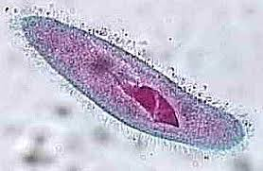
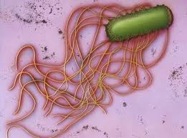
M. Cilia and Flagella
1. Hairlike projections of the cell
  a. cilia - short and many
  b. flagella - long and few
Composed of protein fibres that are able to contract and cause the cilia or flagella to beat or wave back and forth
3. For cell locomotion, or generating current

Slide 32
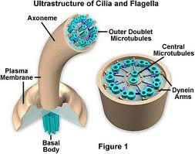
Inside (cross-section):
  a. A "9 + 2" arrangement of
  microtubules
  b. Except: in their basal body (anchor in cytoplasm) where the two central tubules are gone (a "9 + 0" pattern)

Slide 33
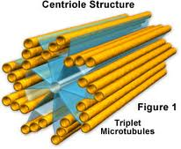
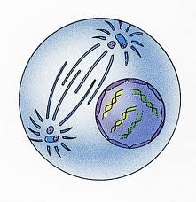
N. Centrioles
Are short cylinders with a “9+0” pattern
Produce the basal bodies of cilia and flagella
Probably involved in some way with the formation of spindle fibres in the mitotic process
Usually 2 centrioles lie on either side of the nucleus (during times of nuclear division)
5. Found in all animal cells

Slide 34
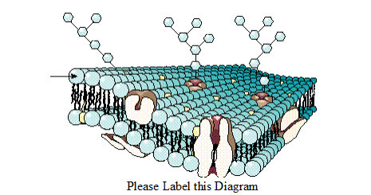
O. Cell Membrane
1. The cell membrane functions in transport of materials in and out of cell, recognition, communication, and homeostasis

Slide 35
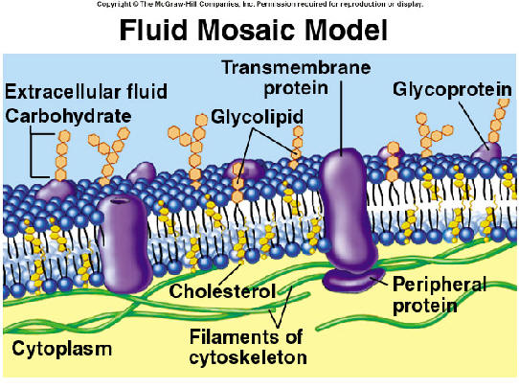
2. The Fluid Mosaic Model:
a. Cells are surrounded by a thin membrane of lipid and protein, about 100 angstroms (100 x 10-10 m) thick.
b. The cell membrane is a remarkable structure that has properties of a solid and a liquid.
c. It forms a "fluid sea" in which proteins and other molecules like other lipids or carbohydrates are suspended (like icebergs) or anchored at various points on its surface.

Slide 36
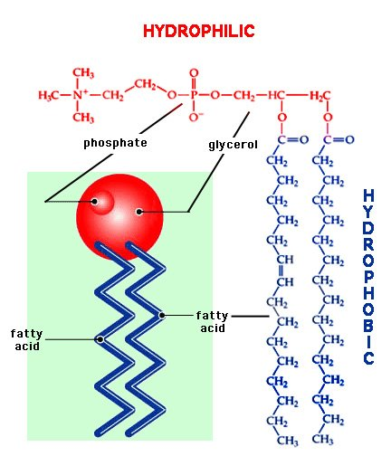
d. The “sea” or “fluid” part is composed of side by side phospholipids arranged in a bilayer (called a lipid bilayer).
e. The solid part (the “mosaic”) is the variety of proteins etc. embedded in the bilayer.
f. Each phospholipid has a hydrophobic tail and a hydrophylic head

Slide 37
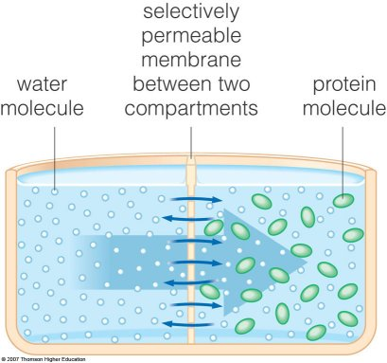
The membrane has consistency of light machine oil.
4. The membrane is selectively permeable (will let some substances in but not others of the same size).

Slide 38
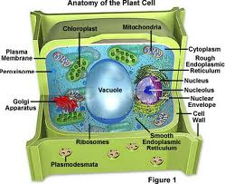
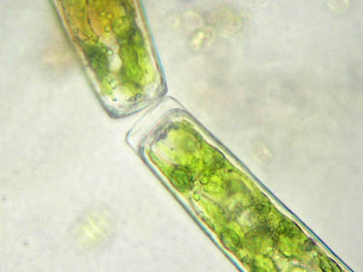
P. Cell Wall
Only in plant cells
Made of cellulose (sugars linked with a strong bond)
Very rigid (but porous) and difficult for animals to digest (think “wood”)
4. Small molecules have little difficulty penetrating the cell wall, while larger molecules may not be able to pass through. (the cell wall is said to be semi-permeable)

Slide 39
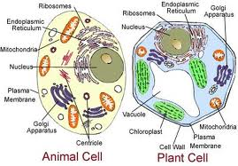
VII.Plant Cell vs. Animal Cell
A. Plant cells have:
  1. A cell wall
  2. Plastids
  3. A large central vacuole… animal cells do not!
B. Animal cells have
  1. Centrioles … plant cells do not!

Slide 40
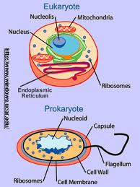
VIII.Prokaryotes vs. Eukaryotes
Two classes of cells exist: the PROKARYOTES and the EUKARYOTES
B. The Prokaryotes include the bacteria and the blue-green algae (the Monera kingdom).
  1. These are all single-celled organisms that lack both a true nucleus and other membrane-bounded cellular substructures.
  2. Prokaryotic DNA is usually circular.

Slide 41
 |  | Eukaryotic
Structure | Prokaryotic | Animal | Plant
Cell Membrane | YES | YES | YES
Cell Wall | YES | NO | YES
Nucleus | NO | YES | YES
Mitochondria | NO | YES | YES
Chloroplasts | NO | NO | YES
ER | NO | YES | YES
Ribosomes | YES, small | YES, large | YES, large
Vacuoles | NO | YES, small | YES
Lysosomes | NO | YES, usually | NO, usually
Cytoskeleton | NO | YES | YES
Centrioles | NO | YES | NO
C. The Eukaryotes include plants, animals, protozoa, and fungi.
  1. These cells contain nuclei and other membrane-bound organelles.
  2. The genetic material is organized into chromosomes.

Slide 42
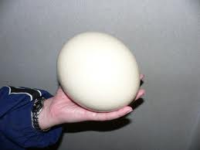
Surface Area To Volume Ratio and
Cell Size
(Why aren’t cells bigger??)
I. Cell
  Contains many structures and are highly organized
  B. May be thousands of each organelle in any given cell
    1. Ex. Mitochondria in muscle cells
  Smallest cell: a pleuro-pnemonia like organism with a diameter of about 0.1 μm
  D. Largest cell: an ostrich egg
Cell Size Animation

Slide 43
II. Ratio of Cell Surface Area to Cell Volume Animation
A. As the size of a cell increases, its surface to volume ratio decreases
A cell measures 1 mm³. Its surface to volume ratio is 6:1
  1. Surface area (for a square): area of one face x 6
  ex. SA = 1 mm x 1 mm x 6 = 6 mm²
  2. Volume: length x width x height
  ex. Volume = 1 x 1 x 1 = 1 mm³

Slide 44
C. If you double the size of the cell to 2 mm across, its surface to volume ratio decrease to 24:8 or 3:1
  1. SA = 2 mm x 2 mm x 6 = 24 mm²
  2. Volume = 2 mm x 2 mm x 2 mm = 8 mm³
  3. When the size doubled, the SA:V ratio decreased by half!

Slide 45
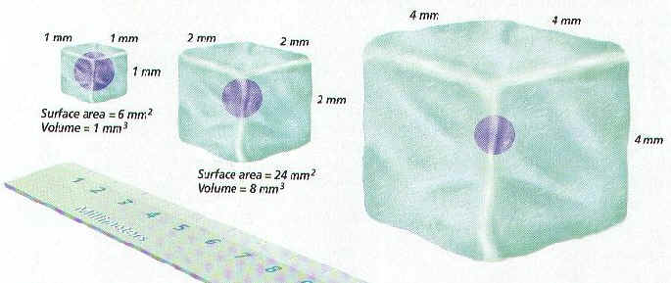
Example:
Cell Size | Surface area | Volume | SA:V Ratio
1 X 1 | 6 | 1 | 6:1
2 X 2 | 24 | 8 | 3:1
4 X 4 | 96 | 64 | 1.5:1
8 X 8 | 384 | 512 | 0.75:1

Slide 46
Example:
Sphere | Radius (cm) | Volume (cm³) | Surface Area (cm²) | SA:V Ratio
1 | 1 | 4.1 | 12.6 | 3:1
2 | 2 | 33.5 | 50.3 | 1.5:1
3 | 3 | 113.1 | 113.1 | 1:1
Volume of Sphere =
Surface Area of Sphere = 4πr²

Slide 47
III. Limitations of Cell Size
When cells get too large, they must divide
Cells cannot get too large because of the way that a cell's volume changes with respect to its cell surface area
As the cell increases in volume the surface area must also increase in order for the cell to take in or get rid of materials (nutrients in: wastes out)

Slide 48
III. Limitations of Cell Size
Diffusion is not a highly rapid or efficient means of distributing materials over long cellular distances, so no portion of even the largest active cells is more than 1 mm from the cell membrane
E. If the surface area is small relative to volume, the cell may build up wastes to such an extent that the cell may die

Slide 49
IV. Solving the Limits of Surface Area To Volume Ratio
A. Cells can divide by mitosis
B. Slow down metabolism
  1. If a cell metabolizes (carries on its cellular activities) at a slow rate it will produce wastes at a slow rate and need fewer nutrients than a cell that metabolizes at a fast rate
  2. A slowly metabolizing cell could then be larger than a quickly metabolizing cell

Slide 50
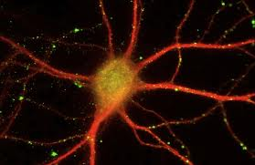
C. Cell shape
  1. Shape of the cell can affect the surface area of the cell
  2. Spherical cell has the smallest surface area to volume ratio
  3. Long or thin or flat cell has a much higher surface area to volume ratio
    a.Get long and thin rather than round and fat: e.g. nerve cells

Slide 51
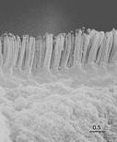
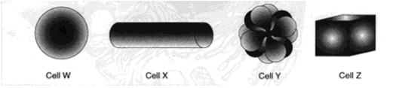
4. Folds in the cell membrane:
  e.g. microvilli of intestinal epithelial cells
Which cell has the most surface area if all 4 cells have the same volume?
Ted Ed: Biggest Unicellular Animal?

