Slide 1
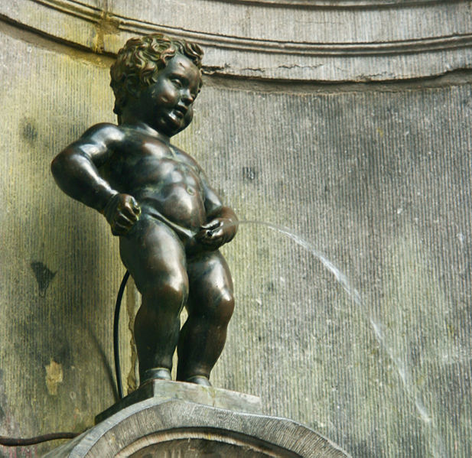
The Urinary System
There are three kinds of men. The one that learns by reading. The few who learn by observation. The rest of them have to pee on the electric fence for themselves. –Will Rogers

Slide 2
I. Excretory System Ted-Ed Kidneys
A. Metabolic wastes must be removed from the body in order to prevent a toxic buildup and possible death.
B. Excretion is NOT the same as DEFECATION, which is the process which rids the body of undigested, unabsorbed food remains and bacteria - NOT metabolic end products.
II. Wastes
A. Nitrogenous waste
1. Ammonia (NH₃)from deamination of amino groups.
2. Very toxic to tissues so it is converted
to UREA by the liver.
O
||
2NH₃ + CO₂ → H₂N – C – NH₂+ H₂O
(urea)

Slide 3
3. Uric acid from the metabolism of
nucleotides.
4. Creatinine from the breakdown of
creatine phosphate (high energy phosphate storage molecule) in muscles.
Bile pigment from RBC recycling.
CO₂ from cellular respiration.
D. Ions from diet.
1. K⁺ 2. Na⁺ 3. Cl⁻
4. Ca²⁺ 5. Mg²⁺ 6. HCO₃⁻
E. Water from cellular respiration and diet.

Slide 4
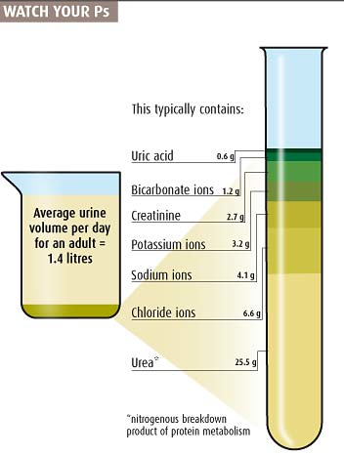
III. Urine
A. A solution of
1. 95% H₂O
2. 5% Solids
a. Nitrogenous wastes
i. Urea
ii. Uric acid
iii. Creatinine
b. Ions
c. Urochrome
i. Yellow pigment from breakdown of heme group in hemoglobin.

Slide 5
IV. Excretory organs
A. Skin
1. Glands excrete perspiration which
consists of:
a. Water
b. Salts
c. Small amount of urea
2. Excretion from the skin is primary for
cooling.
B. Liver
1. Excretes bile salts which contains
pigments that are breakdown products of RBC metabolism.
2. Bile is sent to small intestine.

Slide 6
C. Lungs
1. Excrete CO₂
2. Excrete water
D. Intestine
1. Excretes Salts (Fe⁺, Ca²⁺) into the
intestine which then becomes part of
the feces.
E. Kidney
1. Excretes urine.
2. Regulate blood volume.
3. Regulate pH.
Kidney and Nephron Video

Slide 7
O1. Parts of the Urinary System
I. Urinary System

Slide 8
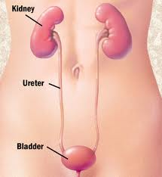
A. Kidneys (Y)
1. Paired reddish-brown organs about 10 cm long, 5 cm wide and 2 cm thick.
2. Anchored against the dorsal body wall by connective tissue.
3. Produce urine.
B. Ureters (W)
1. Pair of muscular tubes.
2. Transport urine from kidneys to
bladder via peristalsis.
C. Bladder (Z)
1. Stores up to 600 mL - 1000 mL of urine.
2. Bladder fills with urine until stretch
receptors signal the brain to urinate.
3. Sphincter muscles can be controlled to
prevent urination until convenient.

Slide 9
D. Urethra (X)
1. Tube connecting bladder to the
outside to allow for the elimination of urine.
2. In females, it is about 4 cm long, opens
to exterior between vagina and clitoris.
3. In male, it is about 20 cm long, opens
to exterior at tip of penis.
4. In males, it is also part of the reproductive system.
E. Renal Artery (V)
1. Carries blood to kidneys from the aorta.
F. Renal Vein (U)
1. Carries blood from kidneys back to the heart.

Slide 10
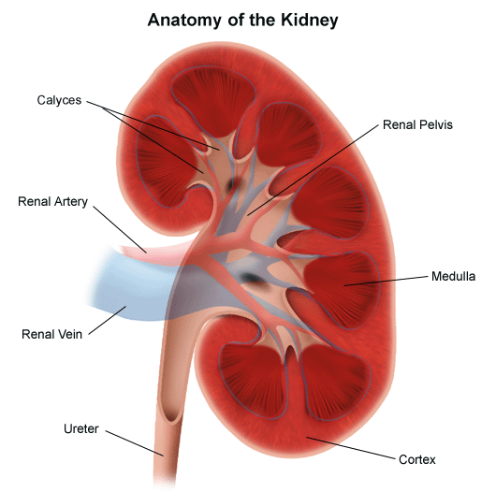
II. Kidney
A. Renal Cortex
1. Outermost layer of
kidney.
2. Granular in appearance.
3. Location of most of the
“work” of the kidney.
B. Renal Medulla
1. Middle layer.
2. Striated cone-shaped masses of tissue.
3. Location of most H₂O reabsorption
and salt balancing.
C. Renal Pelvis
1. Inner layer.
2. Central space that arises from the
joining of many collecting ducts.
3. Merges with the ureter and conducts
urine away.

Slide 11
O2. Nephron Structure and Function
I. Nephron
    Functional units of the kidney.
    Filter wastes from the blood, and retain water and other needed materials.
    About 1 million nephrons per kidney.
D. About 1 mL of urine forms per minute by all the nephrons.

Slide 12
II. Nephron Structure and Function KIDNEY ANIMATION

Slide 13
A. Afferent arteriole (I)
1. Blood vessel entering the glomerulus.
2. Contains ‘normal’ blood.
3. Blood pressure is higher here than in
the efferent arteriole.
B. Efferent arteriole (H)
1. Blood vessel leaving the glomerulus.
2. Travels to the capillary network
surrounding the nephron.
3. Contains ‘thick’ blood with less plasma
C. Glomerulus capillary network (G)
1. Where a large portion of the blood plasma filters from the blood vessels into the Bowman's capsule.

Slide 14
D. Bowman's capsule/glomerular capsule(A)
1. Cup-like end of nephron where plasma is forced out of the blood and into the nephron.
2. Collecting area for blood plasma from
the glomerulus. KIDNEY ANIMATION
3. Blood is PRESSURE FILTERED.
a. Large objects stay inside the glomerulus.
i. Blood cells
ii. Platelets
iii. Proteins (globulins, enzymes, hormones)
b. Small objects are squeezed out of
the glomerulus into the Bowman's capsule.
i. Urea
ii. Nutrients
iii. Salts
iv. Water
c. What ends up in the capsule is
equivalent to blood plasma now called glomerular filtrate

Slide 15
E. Capillary network (D)
1. Nest of capillaries surrounding the
nephron.
2. Reabsorb most of nutrients, H₂O etc.
F. Proximal convoluted tubule (F) KIDNEY ANIMATION
1. Active and passive SELECTIVE reabsorption occurs here.
2. Interior cells have microvilli and many mitochondria.
3. Sugars, amino acid, positive ions are ACTIVELY transported out of filtrate in the nephron and returned to the blood via capillary network.
4. Active transport uses ATP and O_{2.}
5. Specific carrier proteins in epithelial cells bind and transport specific molecules.
6. Negative ions (e.g. Cl⁻) passively flow into the bloodstream due to attraction to the positive ions.
7. The filtrate is now less concentrated than the blood (hypotonic!), so water moves from the filtrate to the blood by osmosis.

Slide 16
G. Loop of Henle/Loop of the nephron (E)
1. Dips down into medulla, then back up
into cortex.
2. Two sections
a. Descending limb
b. Ascending limb
3. Absorbs over 99% of the water in the original filtrate.
4. A hypertonic environment is
maintained in the medulla tissue to aid loop functioning.
5. Function of descending limb:
a. H₂O diffused out of descending
limb because the medulla is more hypertonic compared to the loop.
b. The deeper the filtrate travels into
the medulla, the greater the osmotic gradient so this keeps the water flowing out of the
descending limb.
c. This water is picked up by the
peritubular capillaries and returned to the bloodstream.

Slide 17
6. Function of the ascending limb:
a. IMPERMEABLE to water.
b. Na⁺ and Cl⁻ diffuse passively out
of the lower portion.
c. They are actively PUMPED out at
the top.
d. This action makes the medulla
“salty” (hypertonic)
This pattern is called countercurrent exchange.
KIDNEY ANIMATION
Counter Current Exchange Animation

Slide 18
H. Distal convoluted tubule (B)
1. tubular excretion from the nephron tubule into the capillary network occurs here.
2. Materials that are actively excreted from blood into distal convoluted tubule:
a. NH₄⁺ and H⁺ ions
b. Penicillin
c. Creatinine
d. Histimine
e. Blood pH can be regulated by this
active excretion of H⁺.
I. Collecting duct (C)
1. Many distal tubules feed into one collecting duct.
2. Filtrate that reaches here is isotonic to the blood, due to the reabsorption of water and salt in nephron but the collecting duct travels through same hypertonic medulla, so more water diffuses out of collecting duct, making urine more concentrated.

Slide 19
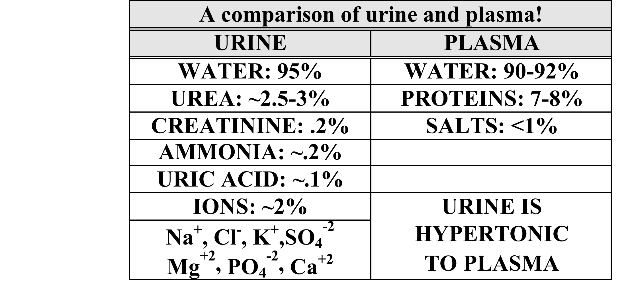
3. Collecting duct area is very important in regulating the overall water content of urine because ADH hormone acts here to regulate permeability to water.
KIDNEY ANIMATION

Slide 20
O3: Blood in Renal Artery and Vein
I. Glucose
A. Renal Artery: 100 mg/L
B. Renal Vein: 98 mg/L
C. Glucose is 100% reabsorbed from the
filtrate into the blood.
  D. 2 mg/L drop results from use of sugar to make ATP to fuel all the active transport that is happening in the tubules.
II. Urea
A. Renal Artery: 30 mg/L
B. Renal Vein: 25 mg/L
C. Urea is lower in the renal vein because it is excreted in the filtrate.
  D. Kidneys do not remove ALL the wastes from the blood; they remove enough to keep waste levels healthy.

Slide 21
O4-O5: ADH and Aldosterone
I. Blood Volume Regulation
A. Done by 2 hormones:
1. ANTIDIURETIC HORMONE (ADH)
2. ALDOSTERONE
II. ADH - Antidiuretic Hormone "Anti Pee"
A. Controls H₂O balance.
B. Secreted by the posterior pituitary gland.
  C. Increases the permeability of the distal tubule and collecting duct so that more water can be reabsorbed back into the blood.
D. If ADH is secreted:
  1. Blood volume increases.
  2. Blood becomes more dilute.
  3. Urine becomes more concentrated.

Slide 22
E. ADH secretion is controlled by the water
content of the blood.
1. Cells in hypothalamus detect
low H₂O content of blood.
2. ADH released into blood, acts on
distal convoluted tubule
and collecting duct.
3. More H₂O reabsorbed so the volume
of urine decreases.
4. Therefore, blood volume increases.
    5. As blood becomes more dilute, this is detected by the hypothalamus, ADH secretion stops (a negative feedback loop!)
    APBI School Animation KIDNEY ANIMATION

Slide 23
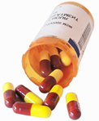
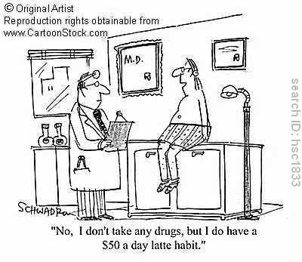
F. Diuretics
1. Chemicals that increase urine output
2. Some examples and their mechanisms:
a. Diuretic drugs
i. Prescribed for high blood
pressure, inhibits ADH
secretion.
ii. Lower blood volume and thus blood pressure (cause increased urination).
b. Caffeine
i. Increases blood pressure.
ii. Increases filtration at
glomerulus.
iii. Lowers Na⁺ reabsorption
iv. Results in increased urine
output.

Slide 24
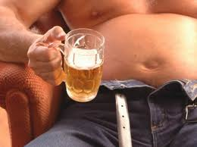
c. Alcohol
i. Inhibits hypothalamus, and thus pituitary’s secretion of ADH.
ii. Results in increased urine output.
iii.Person becomes dehydrated and that leads to a hangover!
iv.Beer and alcohol cannot quench your thirst! (you will urinate more!)
III. Aldosterone
A. Hormone secreted by adrenal cortex (outer layer of the adrenal gland on top of each of the kidneys).
B. Increases reabsorption of Na⁺ back into blood.
C. This encourages water to be reabsorbed, which causes blood volume and pressure to rise.
D. Concentration of sodium in blood regulates secretion of aldosterone.
1. Triggered by low blood volume and/or low blood Na⁺ concentrations cause more aldosterone to be produced.
    2. High blood volume and/or high blood Na ⁺ concentrations cause less aldosterone to be produced.
  (Another negative feedback loop!)

Slide 25

IV. Atrial Natriuretic Hormone (ANH)
A. Secreted by heart atria.
B. High blood volume stretches the cardiac muscles to produce ANH.
C. ANH promotes the excretion of Na⁺ (“natriuresis”).
D. More Na⁺ in urine causes more water to move into urine from blood so the blood volume and pressure drop.
E. ANH also inhibits aldosterone secretion!
V. Kidneys and Blood pH
A. Kidneys help maintain blood pH (H⁺).
B. Nephrons vary the amount of H⁺ and NH₃ that they excrete and the amount of HCO₃⁻ and Na⁺ they reabsorb.
C. If the blood is acidic,
1. More H⁺ and ammonia are excreted.
2. More sodium bicarbonate is reabsorbed.
D. Sodium bicarbonate neutralizes acid.
Na⁺HCO₃- + HOH -----> H₂CO₃ + NaOH
E. If the blood is alkaline,
1. Less H⁺ excreted.
2. Less Na⁺ and HCO₃⁻ reabsorbed.
F. Reabsorption and excretion of ions (e.g. K+, Mg++) by kidneys maintains proper electrolyte balance of blood.

